Slide 1
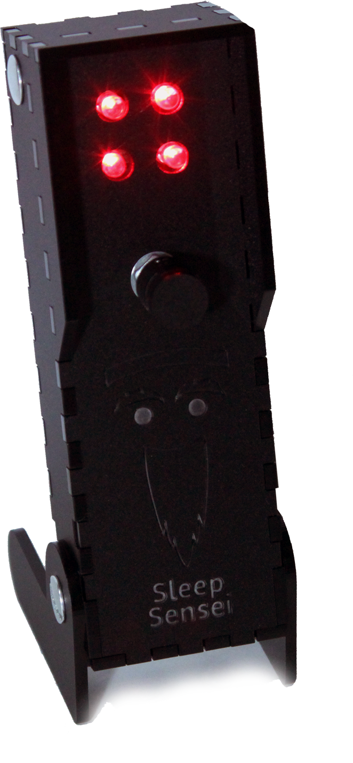
4 Bright LEDs
So you can be coached with your eyes closed
Side Shields
To cut down stray light
Mode Selection
Choose between profiles
Brightness Adjustment
To account for different tastes
Pivoting Base
Allows you to aim the light where it is needed
NOTE: Functional prototype – not final product

